Slide 1
Image Stream
Synchronization for Visual Navigation
大矢グループ i-ROBOT
Helio Perroni Filho

Slide 2
自律走行について「教示・再生」
例示によりロボットに経路を教える
プログラミングより簡単
訓練されているオペレータは要らない
出
発
点
オペレータ
出
先
「教示」ステップ
（人が経路上に）
1.
ロボット
2.
「再生」ステップ
（自律走行）
ロボット

Slide 3
自律走行について「教示・再生」
視覚に基づく自律走行
カメラを使うのは色々な利点が有る：
  ロバスト
  コスト効率の良い
  どこでも有る
  人間に直感的
画像
（「再生」ステップ）
目印
経路修正
「再生」ステップ
画像
（「教示」ステップ）
ドリフ
「教示」ステップ

Slide 4
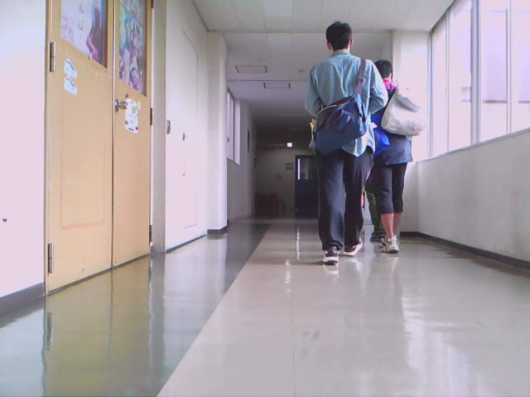
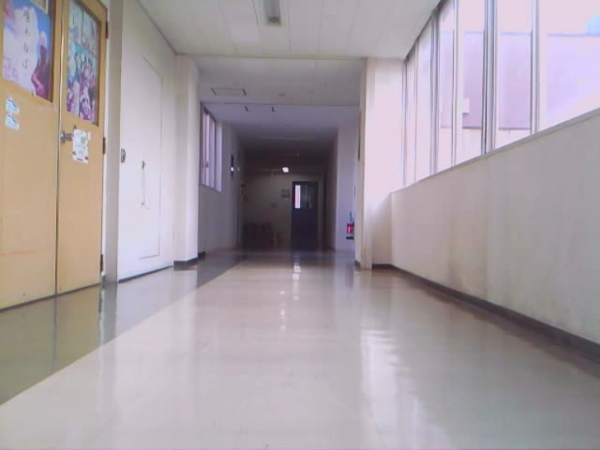
自律走行について「教示・再生」
再生の画像に対応する教示の画像を得るか？
「再生」ステップ
「教示」ステップ

Slide 5
自律走行について「教示・再生」
方法 | 参照 | センサ | 環境 | 変化
 |  |  |  | 照明 | 隠蔽 | 動物体
テンプレート照合 | [5] | 単眼カメラ | 屋内 | × | × | ×
コスト関数の最適化 | [6] | 単眼カメラ | 屋内 | × | × | ×
相互情報量 | [7] | 単眼カメラ | 屋内 | × | ○ | ○
特徴点の追跡 | [8] | 単眼カメラ | 屋内・屋外 | ○ | × | ○
局所最大の相性 | [9] | 単眼カメラ | 屋外 | ○ | ○ | ○
ステレオ特徴点の マッチング | [10] | ステレオカメラ | 屋内 | ○ | ○ | ○
平均ランドマーク ベクトル | [11] | パノラマ式カメラ | 屋内 | ○ | × | ×
オプティカル・フロー | [12] | パノラマ式カメラ | 屋内 | ○ | ○ | ×
特徴点の相互相関 |  | 単眼カメラ | 屋内・屋外 | ○ | ○ | ○
Notes:
Finding invariants that always apply can be tricky, though. Here I show some of the methods that have been proposed over the years – you can find the respective articles on my report's bibliography, these are their reference numbers.
Most of these methods deal with computing a representation that is consistent across image variations, but fall short one way or another. A common limitation is for a method to only work indoors or outdoors. Difficulties on dealing with moving elements, such as people, or occlusions are also common. Some methods also require non-standard hardware, such as stereo cameras.
Therefore, there is still demand for a teach-replay method that works well indoors and outdoors, uses simple hardware such as a single monocular camera, and can deal with changes in lighting and the presence of occlusion and moving objects.

Slide 6
自律走行について「教示・再生」
自分の方法：「特徴点の相互相関」
特性
  画像シーケンスから安定な対応を作る
  カメラ校正は要らない
  照明変化・隠蔽面・動物体にロバスト
  屋内も屋外も使える
Notes:
The limitations of current visual teach-replay methods have motivated me to look for a new solution, which I call Differential Visual Streams, or “DiVS” for short.
It works on image sequences, generating stable representations that are robust to changes in lighting, occlusions and the presence of moving elements. It is applicable to indoors and outdoors environments, requiring a single, uncalibrated monocular camera as input. Last but not least, it is fast to compute, being convenient for real-time operation.
Therefore, DiVS provides a sound base for the implementation of teach-replay on visual input.

Slide 7
目次
自律走行について「教示・再生」
特徴点の相互相関による対応画像の発見
実験結果
まとめ
Notes:
The DiVS method and its application to teach-replay are the subjects of the remainder of this presentation.
In the next section I describe the DiVS method. Then I show how it can be used to implement a teach-replay control module for a mobile robot.
Next I show the results of a number of experiments made with the control module, what conclusions can be drawn from those results, and discuss directions for further research.

Slide 8
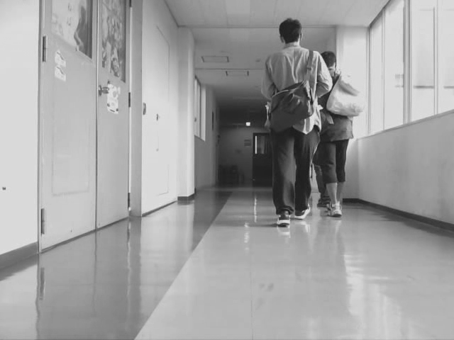
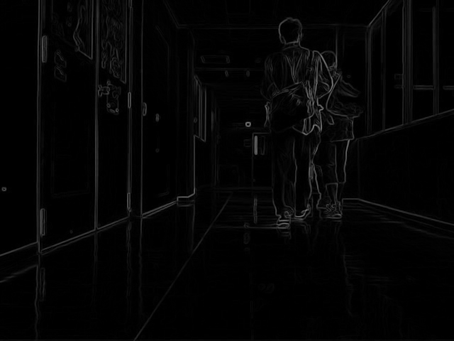
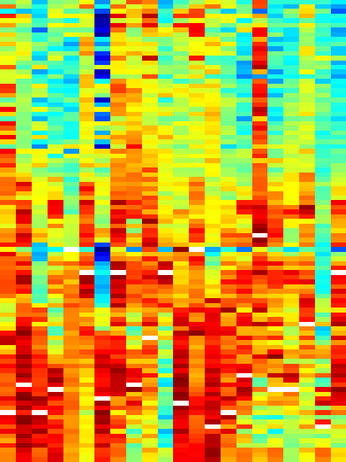
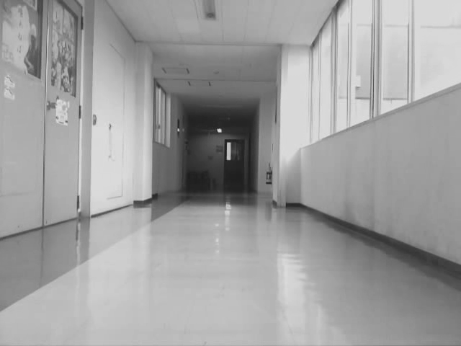
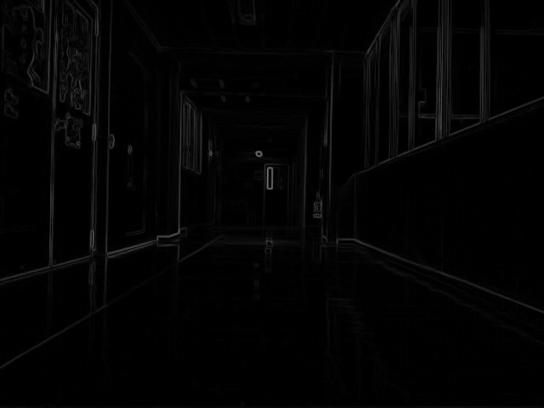
特徴点の相互相関
IiはI'jのベストマッチ
pi,kはp'j,kの
ベストマッチ
...
0
...
4
…
3
…
P
p'j,k
「再生」画像
I'j
P(I'j) = [p'j,1, ..., p'j,z]
pi,k
⭑
p'j,k
P(I'j)
∑
Qi
ℙ
pi,k
「教示」画像シーケンス
St = [I1, ..., Im]
ℙ(St) = [Q1, ..., Qm]
Qi = [pi,1, ..., pi,z]
p'j,k
P(I'j)
Notes:
Given a sequence of gray-scale images, the changes between successive images can be represented by the pixel-by-pixel absolute differences between them. The darker regions of such difference images show where the two images are very similar to each other, and the brighter regions, where they are different. This separation between “change” and “no change” regions can be enhanced by the application of a thresholding operation, such as Otsu's method.
These thresholded difference images provide representations stable to lighting changes, but they are still affected by occlusions and moving elements. In order to account for that, we smooth out such transient changes by calculating the average over a sequence of difference images.
These are what I call differential images, they show the amount of change in different regions of the visual field over a sequence window of some size w. Brighter pixels show high amounts of change, and darker ones, low amounts.

Slide 9
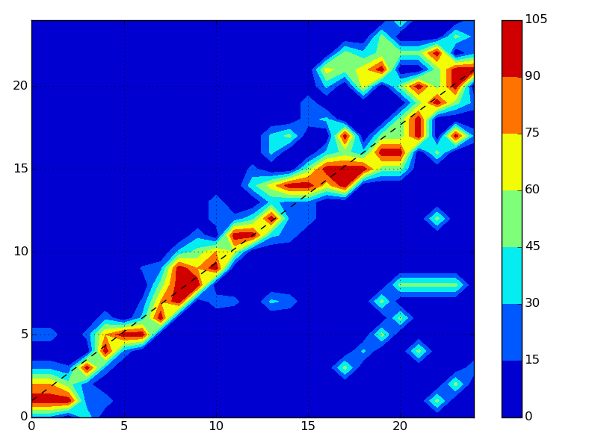
特徴点の相互相関
...
0
...
2
…
3
…
...
0
...
4
…
3
…
...
4
...
2
…
0
…
...
...
Ii
「教示」画像のインデックス
「再生」画像のインデックス
I'j
P(I'1)
P(I'j)
P(I'n)
Notes:
Given a sequence of gray-scale images, the changes between successive images can be represented by the pixel-by-pixel absolute differences between them. The darker regions of such difference images show where the two images are very similar to each other, and the brighter regions, where they are different. This separation between “change” and “no change” regions can be enhanced by the application of a thresholding operation, such as Otsu's method.
These thresholded difference images provide representations stable to lighting changes, but they are still affected by occlusions and moving elements. In order to account for that, we smooth out such transient changes by calculating the average over a sequence of difference images.
These are what I call differential images, they show the amount of change in different regions of the visual field over a sequence window of some size w. Brighter pixels show high amounts of change, and darker ones, low amounts.

Slide 10
目次
自律走行について「教示・再生」
特徴点の相互相関
実験結果
まとめ
Notes:
The DiVS method and its application to teach-replay are the subjects of the remainder of this presentation.
In the next section I describe the DiVS method. Then I show how it can be used to implement a teach-replay control module for a mobile robot.
Next I show the results of a number of experiments made with the control module, what conclusions can be drawn from those results, and discuss directions for further research.

Slide 11
実験結果
システムパラメーター
  並進速度 v = 0.3m/s
  画像サイズ640x320、入力周波数1Hz（毎秒1画像）
  推定に用いる画像シーケンス の数w = 25
  パラメーター(α, β, z) = (30, 90, 10)
実験環境・経路
「室内」実験
「屋外」実験
「教示」ステップ
「再生」ステップ
2°
「再生」ステップ
-2°
「教示」ステップ
20m
15m
Notes:
All field test procedures were performed under the same system parameters as shown here.
During teach and replay steps I record odometry to provide an approximation for the robot's true location. Despite its limitations it is good enough for the scale of these tests.
Teach step paths were just straight paths from the start point, with a length of 10 meters. Several teach paths were recorded. Starting from a common initial pose, the robot would make an initial in-place turn of up to 10°, and then set off in a straight line.

Slide 12
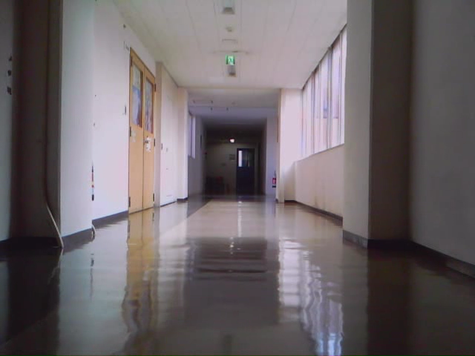
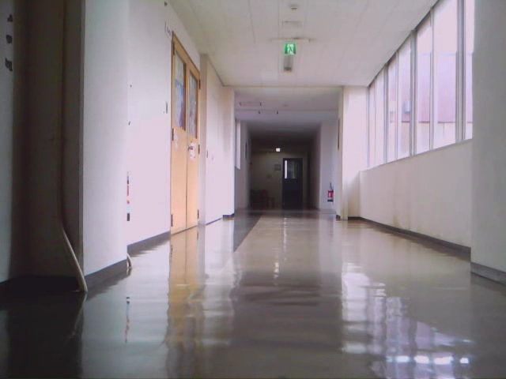
実験結果
「室内」実験
教示
「教示」画像のインデクス
再生
「再生」画像のインデクス
良い結果
画像シーケンスの不対応は少ない
Notes:
Despite the differences in visual conditions and the presence of a moving element for much of the test record, the computed shifts for the 0° case either zero or negligible, correctly indicating the robot is treading much the same path as in the reference record.
Results were very good for the 5° drift cases too: shift direction agrees with drift's, and numerical values are consistent.
By the way, the time my implementation took to generate a single DiVS image on my lab notebook was 0.04 seconds on average.

Slide 13
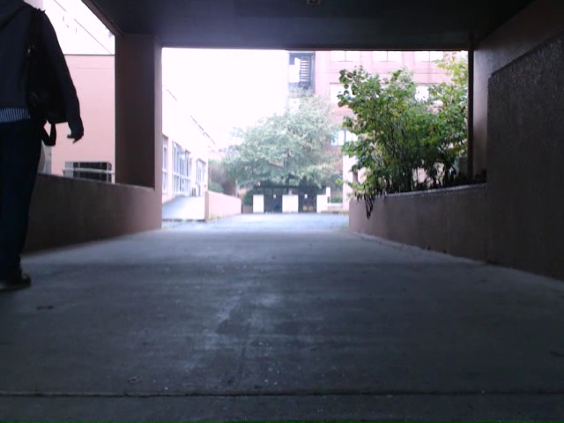
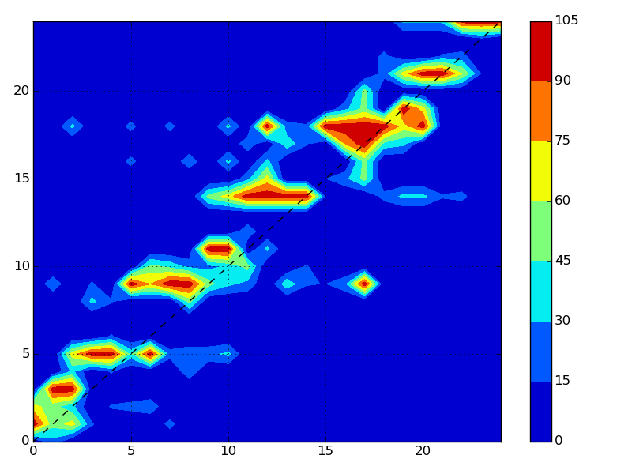
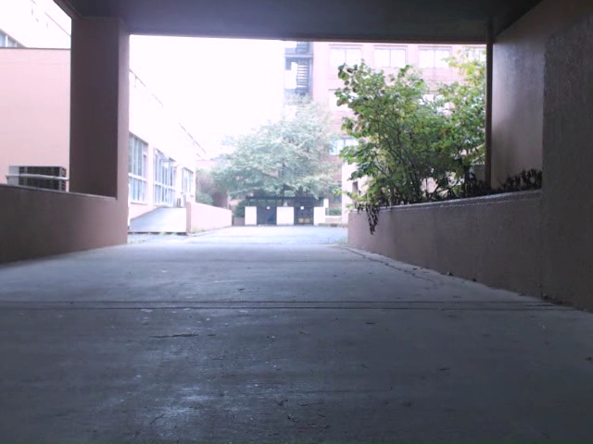
実験結果
「屋外」実験
教示
「教示」画像のインデクス
再生
「再生」画像のインデクス
ほぼ良い結果
Notes:
Despite the differences in visual conditions and the presence of a moving element for much of the test record, the computed shifts for the 0° case either zero or negligible, correctly indicating the robot is treading much the same path as in the reference record.
Results were very good for the 5° drift cases too: shift direction agrees with drift's, and numerical values are consistent.
By the way, the time my implementation took to generate a single DiVS image on my lab notebook was 0.04 seconds on average.

Slide 14
目次
自律走行について「教示・再生」
特徴点の相互相関
実験結果
まとめ
Notes:
The DiVS method and its application to teach-replay are the subjects of the remainder of this presentation.
In the next section I describe the DiVS method. Then I show how it can be used to implement a teach-replay control module for a mobile robot.
Next I show the results of a number of experiments made with the control module, what conclusions can be drawn from those results, and discuss directions for further research.

Slide 15
まとめ
特徴点の相互相関は画像シーケンスから対応を作る
対応は安定、環境の変化にロバスト
今後の予定
  さらに実験
  パフォーマンス向上
  他の線を対応する方法をやってみる（例：RANSAC）

Slide 16
終わり
以上
Notes:
This is the end of my presentation. Any questions?

